Slide 1
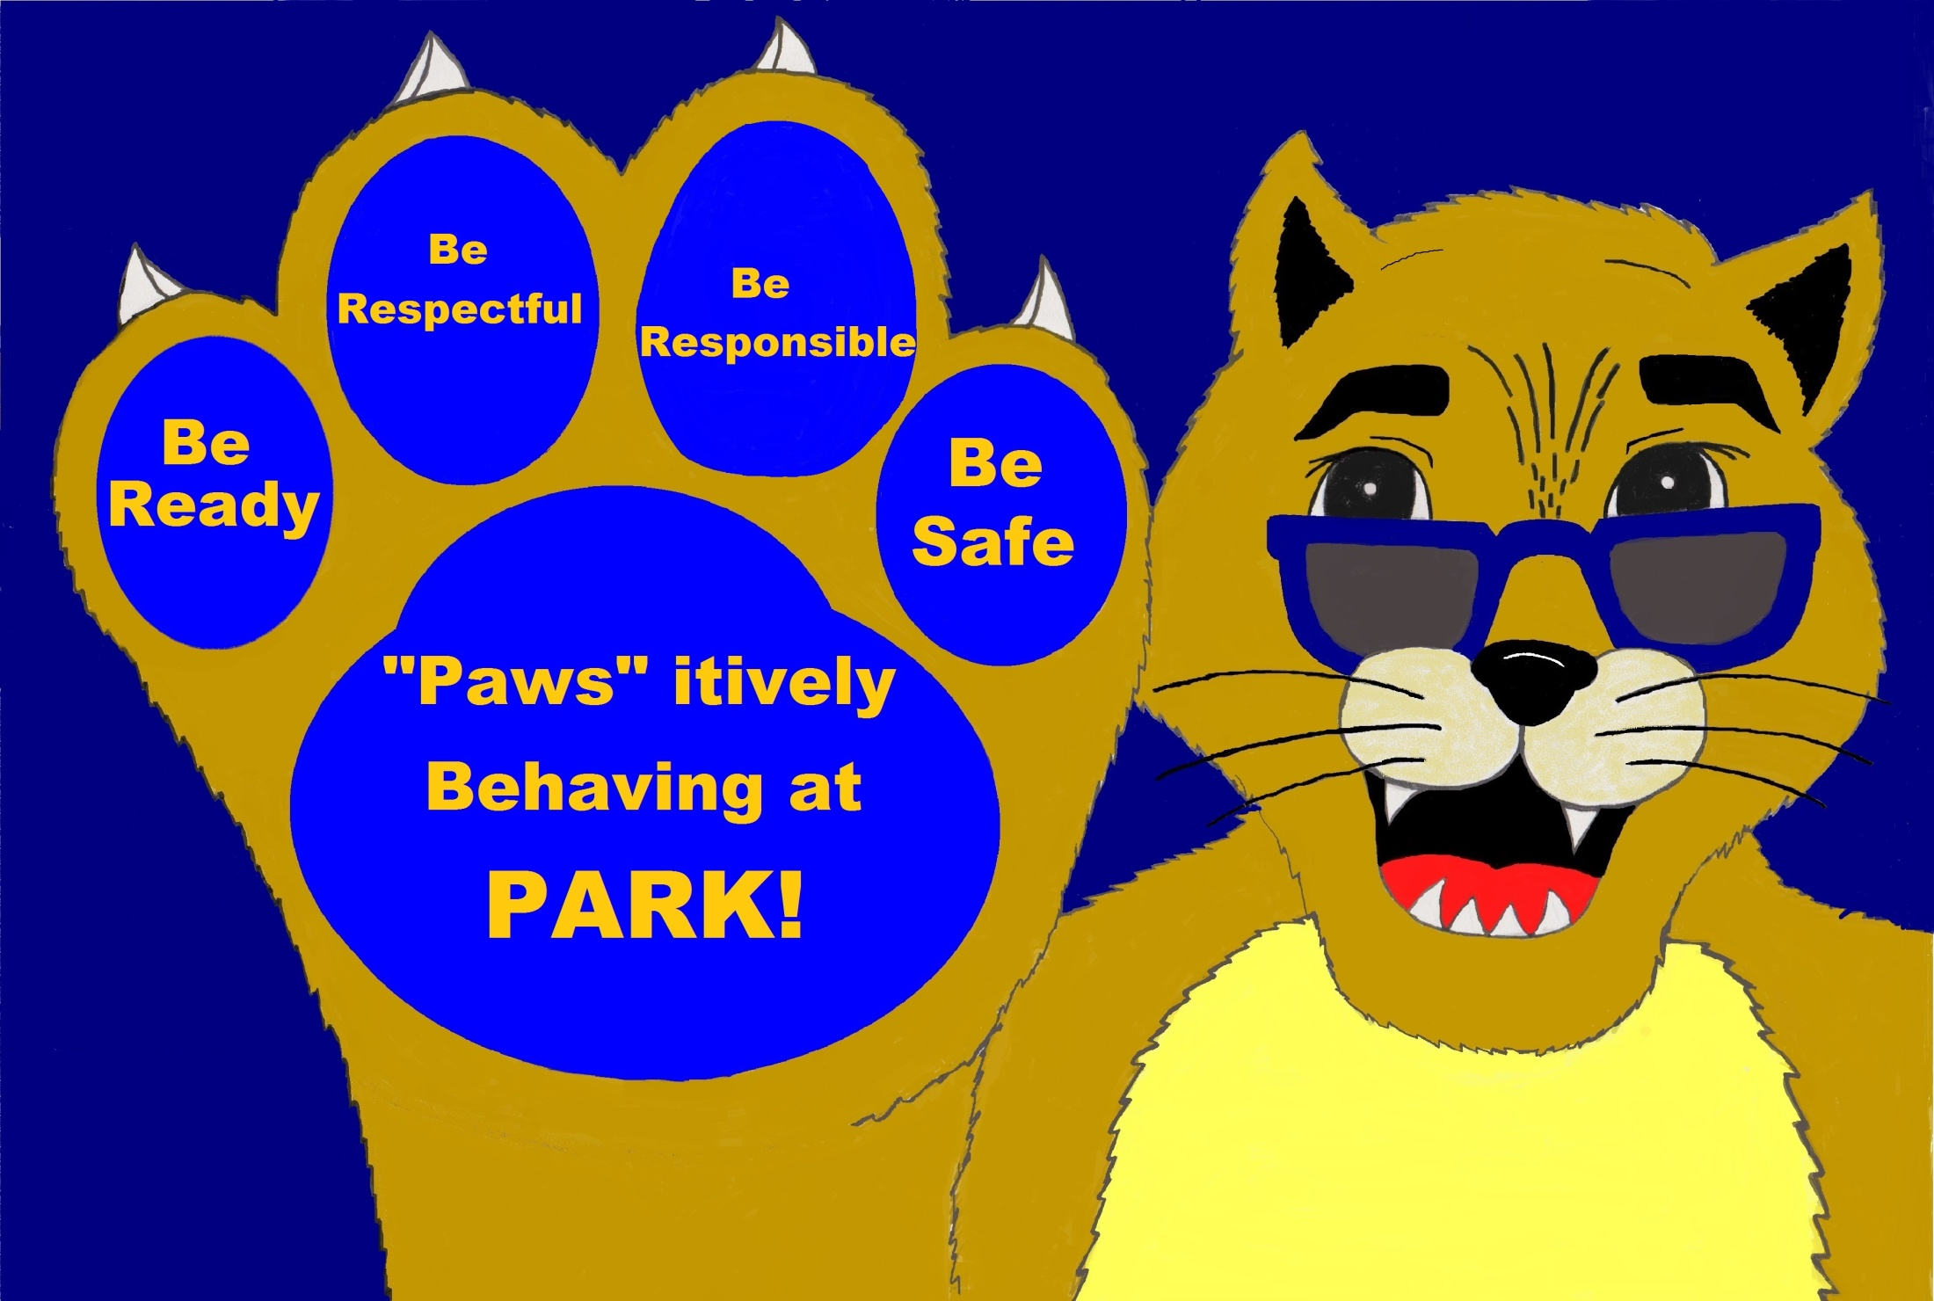
PBIS
Positive Behavior Intervention and Support

Slide 2
What is PBIS?
Prevention not punishment
Management program not a discipline plan
School-Wide common expectations
Correct behavior calmly, consistently, and immediately

Slide 3
Let’s all read off the SAME menu...
MENU
PBIS
Be Respectful
Be Responsible
Be Safe
Be Ready

Slide 4
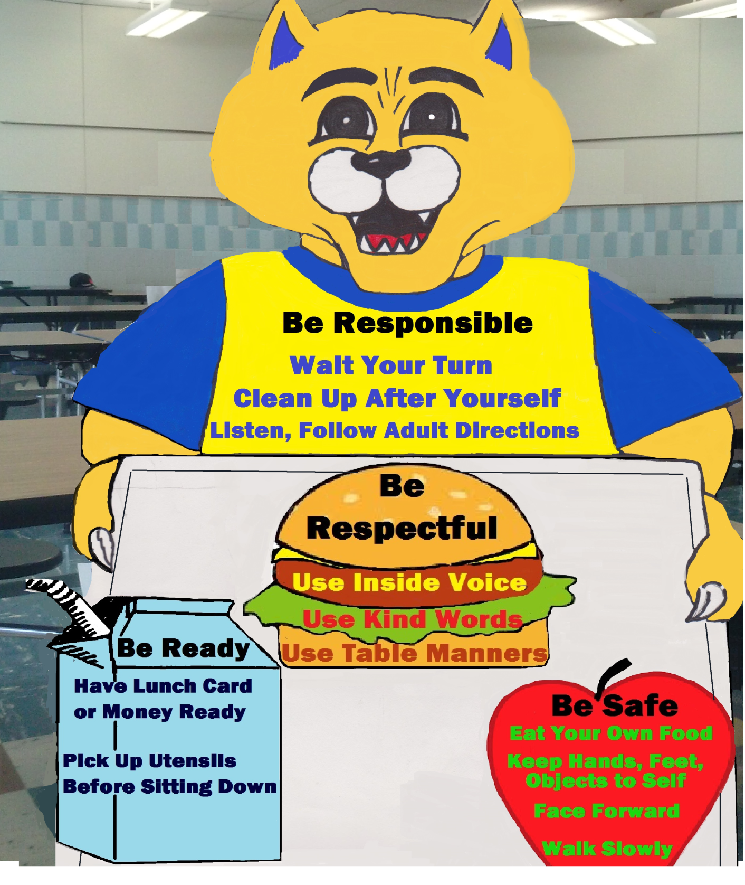

Slide 5
We Need EVERYONE! Administration, Teachers, Students, Parents, and Volunteers
Rehearse expectations
A few minutes prior to lunch (Teacher)
Role play elements of expectations with your class
What does “Be Ready” look like in the cafeteria? Can someone show me?
Hands to your side
Walk on the right
What should “Be Respectful” sound like in the cafeteria?
Voices should be at a low level

Slide 6
We Need EVERYONE! Administration, Teachers, Students, Parents, and Volunteers
All staff outside of the classroom must have the same language
It takes every adult in the school to model expectations
Modeling must be seen 100% of the time
If we give 50% we can only expect the students to do the same
Climate is controlled by the behavior of all staff
Be Firm, Fair, and Consistent
Monitoring in the cafeteria means you are vigilant
Walking up and down the aisle
Being positive
“ I love how you all are being respectful of others by keeping your voice level low thank you.”
Redirect behavior calmly, consistently, and immediately

Slide 7
Matrix
EDGAR PARK ELEMENTARY –CODE OF CONDUCT
 | CAFETERIA | BREEZEWAY
BE READY | Have lunch card and money ready Pick up utensils for all your food before sitting at the table. | Face forward
BE RESPECTFUL | Use inside voice Use kind words Use table manners | Keep hands and feet to self Use quiet voices
BE Responsible | Listen and follow directions Wait your turn Follow directions | Follow directions Walk in a straight line Be quiet
BE SAFE | Walk slowly Face forward stay together Keep hands and feet to your self Eat your own food | Always walk Hold rail Stay on the right hand side

Slide 8
Procedure Pictorials

Slide 9
Entrance Procedures
Enter through right door
Last person closes door
Teachers walk students into cafeteria
Students should be on blue line

Slide 10
Monitor Locations
Monitors will be given stations once we have consistent volunteers and staff who are willing to help out
Locations are indicated by the purple stars
Students must see consistency

Slide 11
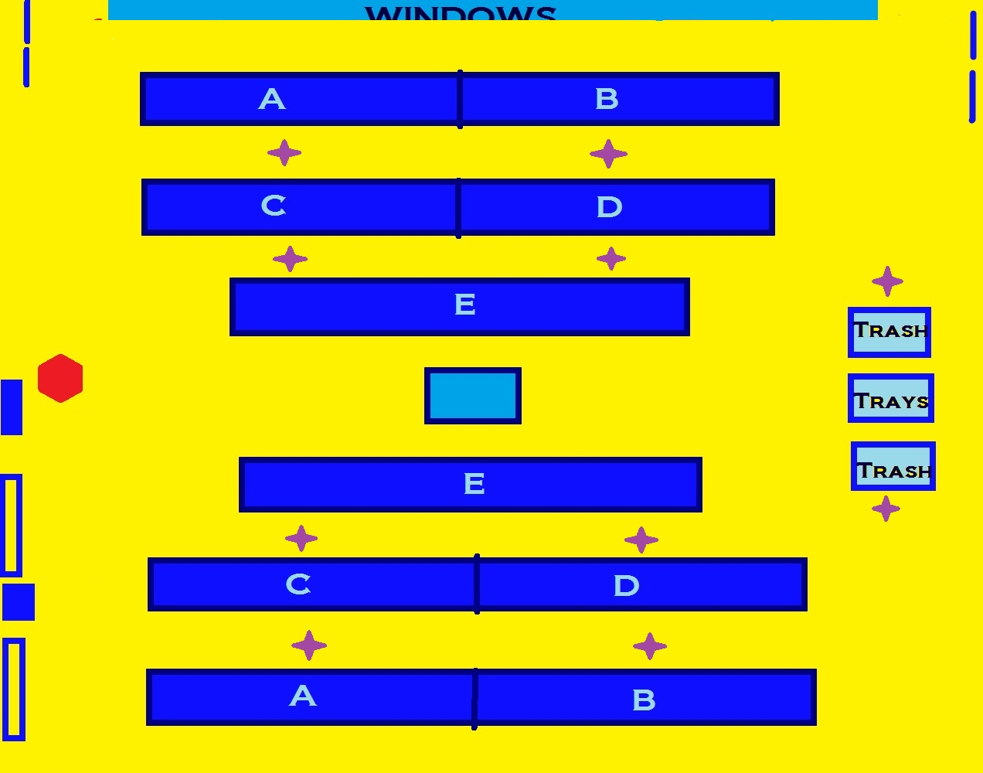
Monitor Locations

Slide 13
Discarding Trash
Two monitors one at one end of the table one at the other
Ask calmly if students are ready to throw trash
Remind students to pick up all trash
Have students on both sides of table stand with tray/trash in hand
Students on right side of table will:
dump trash
stack tray
return back to their seat
left side will follow

Slide 14
Exit Procedure
Students will exit out of right doorway
Straight line (no pairs)
Walk quietly down the breezeway (paw prints) to monitor

Slide 15
POSITIVES
Custodians are happy
Individuals have reported this is the cleanest they have seen the cafeteria
Less congestion
Noise level is down
Less accidents

Slide 16
Suggestions…
Administration present during lunch hours
Volunteer guidance from an Admin or P.B.I.S. staff during lunch sessions to ensure expectations are being implemented
Establish place for Feedback Suggestion Box
Additional time between lower level classes to relieve congestion
Additional monitor to help P.E. coaches

Slide 17
Many thanks to all who have helped in the cafeteria. Language is a key factor in the power of intention. Words create experiences. Words are power. When you say “I can’t,”you won’t. When you say “I won’t,” you don’t… So be POSITIVE!!
Created by your
P.B.I.S. Team

